Slide 2
Computational approaches for the therapeutic target discovery to ame-liorate muscle wasting during aging and disease
Msc Karen Guerrero Vazquez
Dr. Katarzyna Whysall
Dr. Pilib O Broin

Slide 3



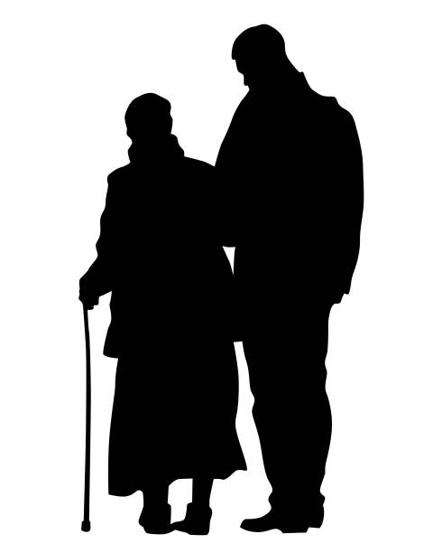

Notes:
Our lives are full of changes, we grow up getting stronger and smarter, but at certain point, we start to call it growing older. And one of the most striking effects of aging is the loss of muscle mass, strength and functionality

Slide 4
~3 – 8 %
Loss of muscle mass per decade
Brocklehurst, 1976
Notes:
. From the time you are born to around the time you turn 30, your muscles grow larger and stronger. But at some point in your 30s, you start to lose muscle mass and function. Is expected a loss of 3 to 8% of muscle mass per decade after age 30, and this rate of decline is even higher after the age of 60. Sarcopenia is associated with detrimental clinical outcomes, such as a reduced quality of life, frailty, an increased risk of falls, fractures, hospitalization, and mortality.
4

Slide 5
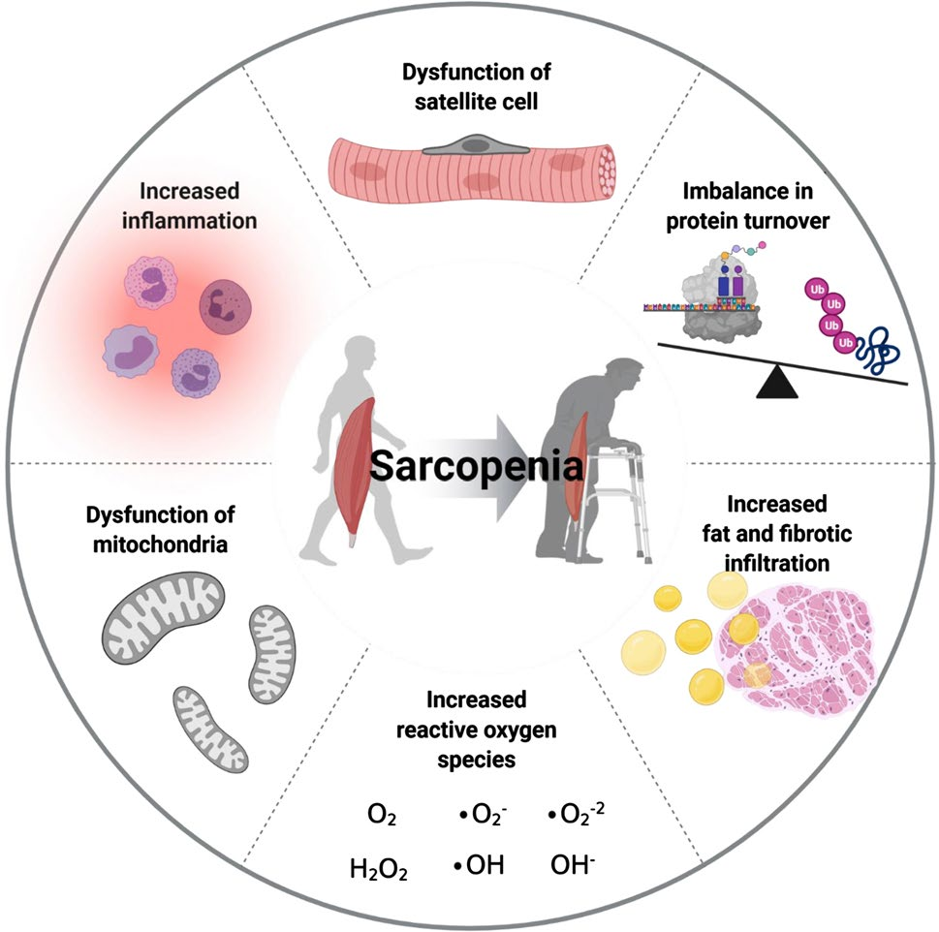
Notes:
Sarcopenia refers to the gradual loss of skeletal muscle mass and function along with aging and is a social burden due to growing healthcare cost associated with a super-aging society. Several factors, including chronic inflammation, increased reactive oxidative species, increased fibrosis of muscle, and increased loss of motor neurons, have been reported to contribute to development of sarcopenia

Slide 6

MicroRNA (miRNAs)
Notes:
MicroRNAs (miRNAs) are small single-stranded RNAs that play an important role in the regulation of gene expression. Their simultaneous regulation of multiple genes and pathways and ability to deliver miRNAs into most tissues without inducing systemic immune response, makes them attractive therapeutic candidates.

Slide 7
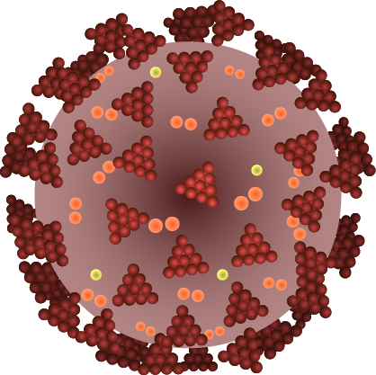
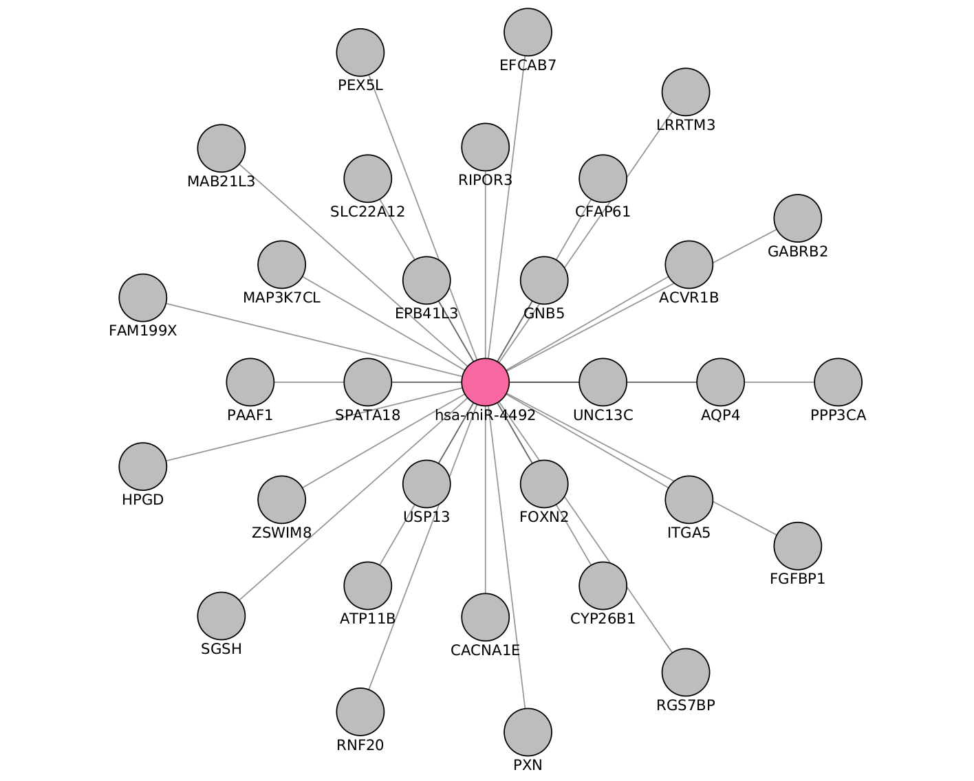
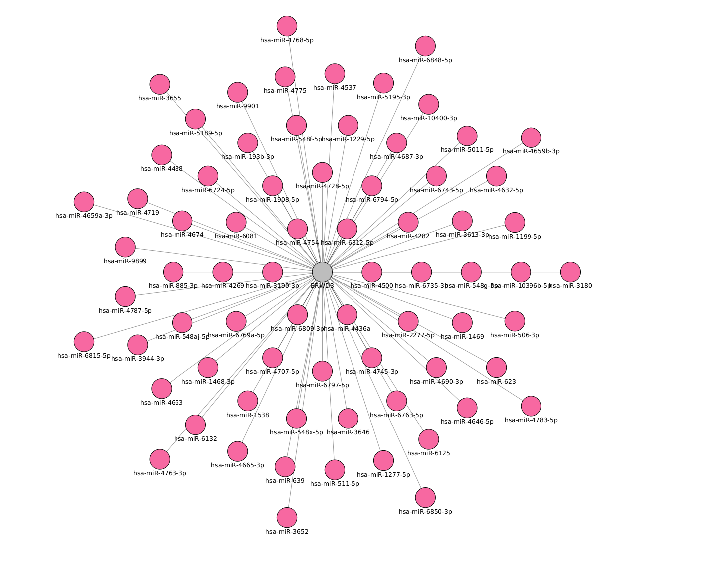
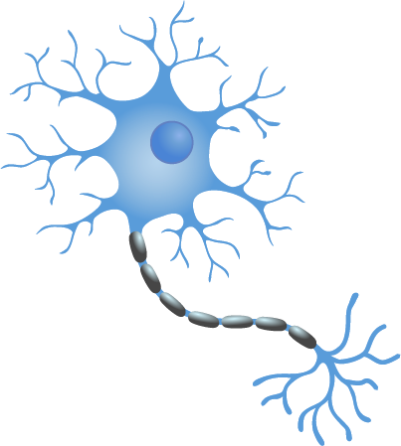
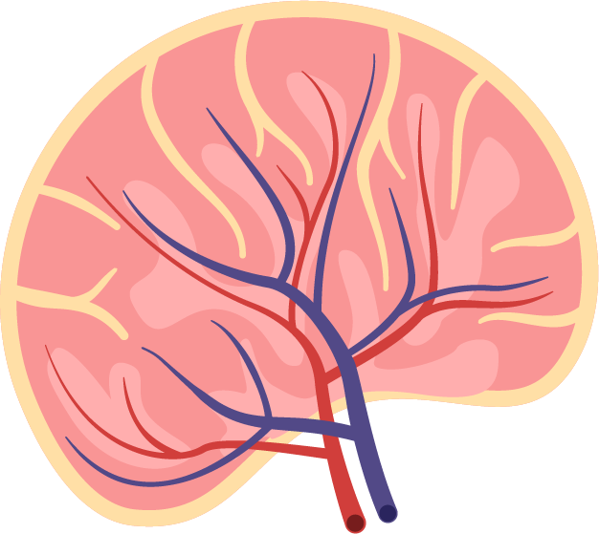
MicroRNA (miRNAs)
Notes:
miRNAs are often ubiquitously expressed, have overlapping functions and can regulate multiple genes. Also, not all miRNAs are functionally relevant in a given cell type.

Slide 8
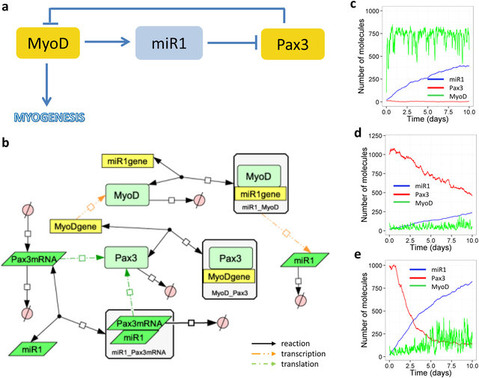
Objective
Create independent models and a common model of miR:target interactions in muscle loss during aging and critical illness based on differentially expressed (DE) miRs and genes
Identification or shortlisted microRNAs as candidates for therapeutics targets against sarcopenia.
Carole J. Proctor & Katarzyna Goljanek-Whysall, 2017, Using computer simulation models to investigate the most promising microRNAs to improve muscle regeneration during ageing

Slide 9






Tools to analyze miRNAs
Notes:
There are more than 160 different tools, apps, and databases dedicated to the study of microRNAs. miRBase, miRWalk, and miRNet are among the most popular.
miRBase is a state-of-the-art database of microRNA sequence annotations.
miRNet integrates user data with existing knowledge via network-based visual analytics.
miRWalk is an online resource for the prediction of microRNA (miRNA) target interactions and integrates results from TargetScan, miRDB, miRanda, and other popular databases.

Slide 10
Tools to analyze miRNAs

Slide 11



Tools to analyze miRNAs

Slide 12
Tools to analyze miRNAs

Slide 13
Tools to analyze miRNAs

Slide 14
Tools to analyze miRNAs

Slide 15
Tools to analyze miRNAs

Slide 16
Tools to analyze miRNAs

Slide 17
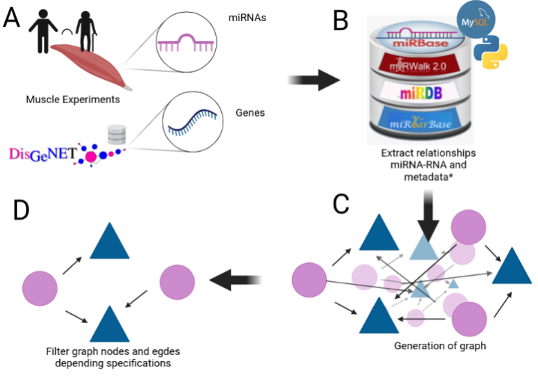
Notes:
Our plan is to take microRNAs or genes, get information from them such as target:miRNA relationship, interactions among them, tissues, etc. This information represented on a graph with thousands of nodes and connections. The graph then is pruned.
17

Slide 18
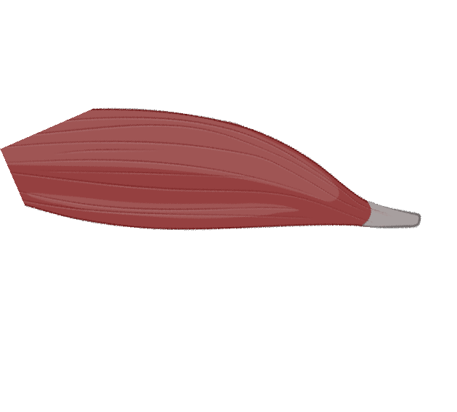
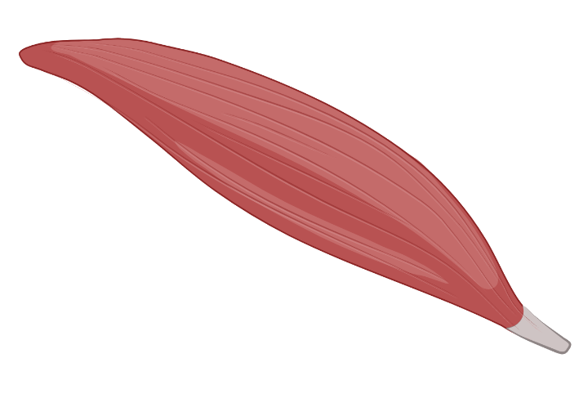
How to start
Notes:
In order to do that, we need to find what are the genes that make a difference form young muscle to old. The differentially expressed genes.

Slide 19
My Experiments
Target | Type | N. Experiments | Healthy | Non healthy
mRNA | RNAseq | 3 | 3 | 0
 | Microarray | 4 | 2 | 2
miRNA | Microarray | 2 | 2 | 0
 | miRSeq | 1 | 0 | 1
Notes:
We have 10 experiments between microarrays, RNASeq, miRSeq, healthy and unhealthy patients. All skeletal Muscle.

Slide 20
Expression during age
max
Expression
min
20
25
30
35
40
45
50
55
60
65
70
75
80
Age
Figure 2: change of gene expression by age
Notes:
This graph was obtained by normalizing from 0 to 1 the expression of selected genes on experiment GSE164471 and plot the average expression of the samples of that age.

Slide 21
Expression during age
max
Expression
Y
<35>
MA
<65>
O
min
20
25
30
35
40
45
50
55
60
65
70
75
80
Age
Figure 2: change of gene expression by age
Notes:
During middle age, we have plenty of changes that are important to look at in order to differentiate between underlying mechanism and compensatory mechanism. Therefore, we divide of groups on Young (<35), middle age (35-60) and Old(>60).

Slide 22
Experiments
GEO number | Samples | Min Age | Max Age | Reference
GSE152558 | 5 | 41 | 85 | Tharakan, R., Ubaida-Mohien, C., Piao, Y., Gorospe, M., & Ferrucci, L. (2021).
GSE164471 | 53 | 34 | 80 | Tumasian III, R. A., Harish, A., Kundu, G., Yang, J. H., Ubaida-Mohien, C., Gonzalez-Freire, M., ... & Ferrucci, L. (2021).
GSE157585 | 136 | 19 | >65 | Kulkarni, A. S., Peck, B. D., Walton, R. G., Kern, P. A., Mar, J. C., Windham, S. T., ... & Peterson, C. A. (2020).
GSE87105 | 16 | 30 | 78 | Mercken, E. M., Capri, M., Carboneau, B. A., Conte, M., Heidler, J., Santoro, A., ... & de Cabo, R. (2017)..
GSE23527 | 36 | 29 | 76 | Drummond, M. J., McCarthy, J. J., Sinha, M., Spratt, H. M., Volpi, E., Esser, K. A., & Rasmussen, B. B. (2011)
Notes:
Until now, we are only using healthy patients where the only variable is Age*

Slide 23
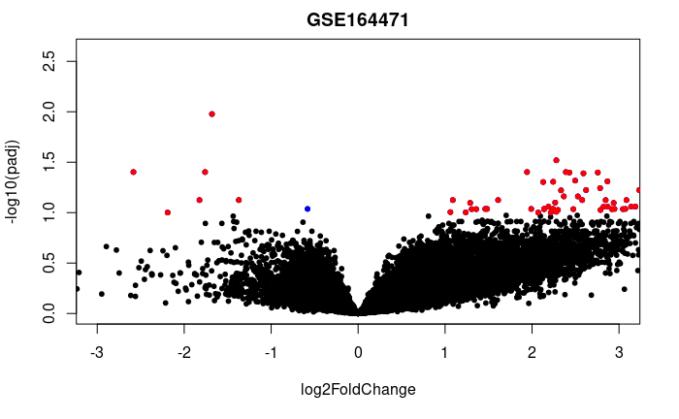

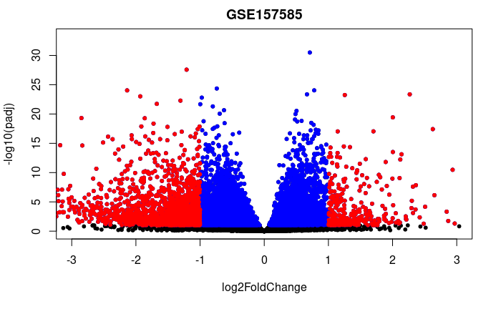
GSE152558
GSE164471
GSE157585
GSE87105
GSE23527
Notes:
We got the differentially expressed genes from each experiment separating by young, middle age and old. Some experiments like GSE152558 only have two of the categories so we worked as the data allowed us.

Slide 24
Differentially Expressed Genes
Experiment | Evaluation | Regulation | Genes
GSE152558 | MO | UP | 8
GSE152558 | MO | Down | 9
GSE157585 | YO | UP | 9
GSE157585 | YO | Down | 73
GSE164471 | YO | UP | 5
GSE164471 | YM | UP | 2
GSE164471 | MO | UP | 6
GSE164471 | YO | Down | 8
GSE164471 | YM | Down | 2
GSE164471 | MO | Down | 11
GSE23527 | YO | Up | 1
GSE23527 | YO | Down | 5
GSE875105 | OY | Down | 88
GSE875105 | MO | Up | 6
GSE875105 | OY | Up | 18
Notes:
24

Slide 25
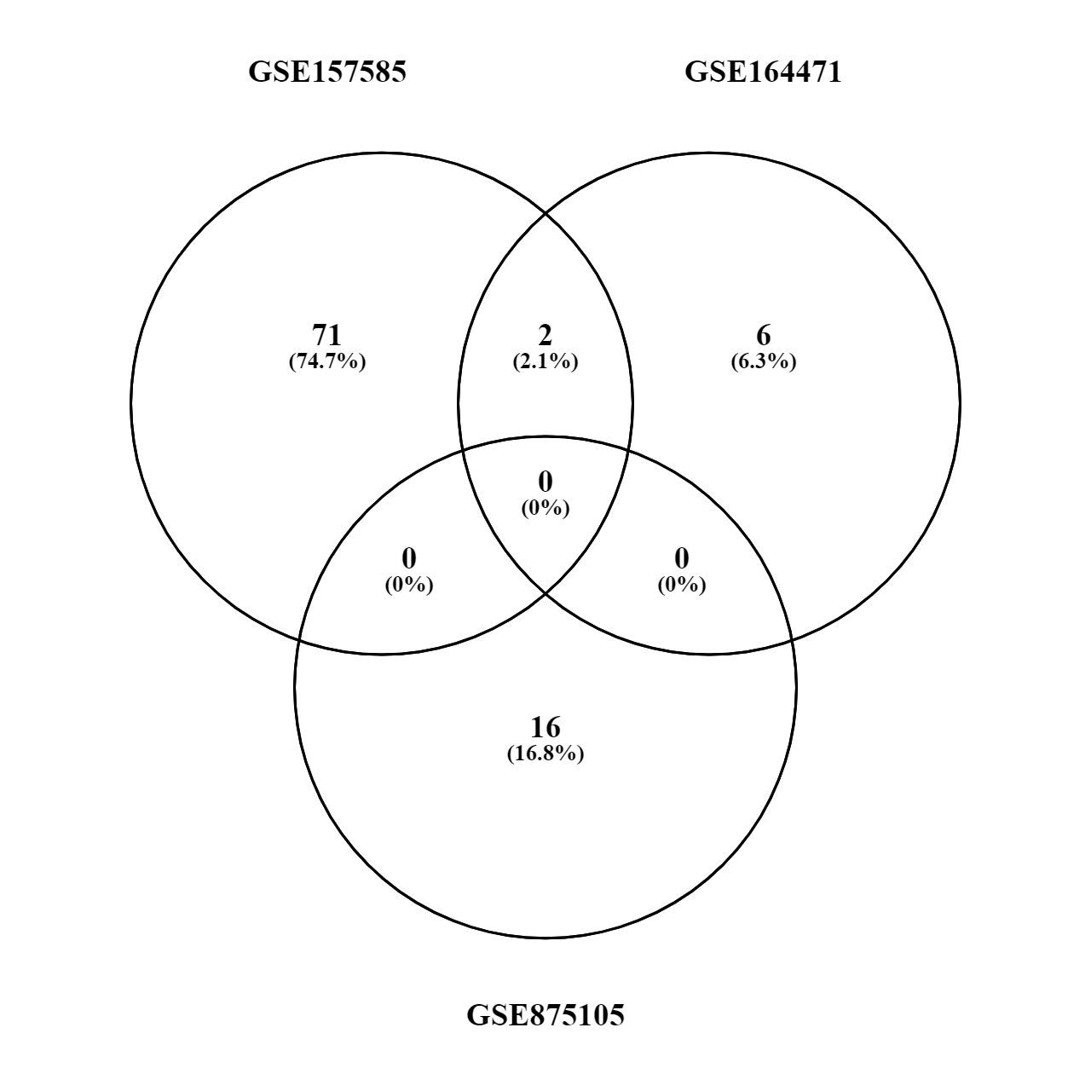
Old vs Young (up or down)
MYH8
HCN1
Notes:
We exceture different comparasions: Experiments, group ages withing a experiment, experiments within age groups, we got some frequent genes like
MYH8
HCN1
MTCO1P12
FAM96A
PAQR4
CISD1
FH
AIFM1

Slide 26

Notes:
Once we have the genes, we need to select the microRNAs, for this, we are approaching two methodologies; using the state of the art Mirnet that already select the genes, microRNAs and select them, and a in home approach that we call miRKat.

Slide 27

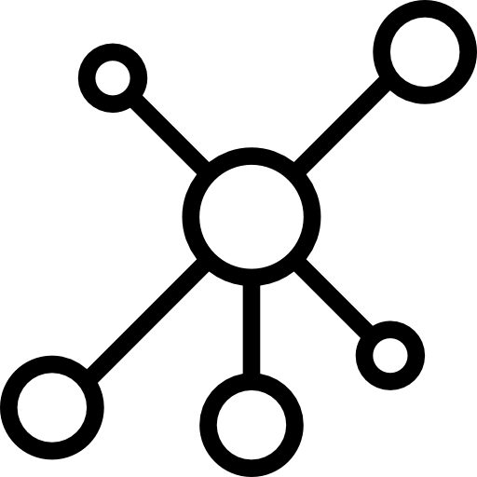
Notes:
Generalizing the pipeline, we got a set of differentially express genes from all the age groups combinations of 2, separated by up and down regulated.
This genes than enter to weather miRKat or mirNet, and as output we have small network with some few microRNAs and genes involved.

Slide 28



446 genes
2k miRNAs
3.5 edges
5 miRNAs
146 genes
163 edges
20 genes
446 genes
1.2k edges
Notes:
For Mirnet, we select the differential express genes as well, then we get the relationship among these genes generating the first network, then adding the microRNAs using different sources and pruning the graph with two different centralities; closeness centrality and PageRank centrality

Slide 29
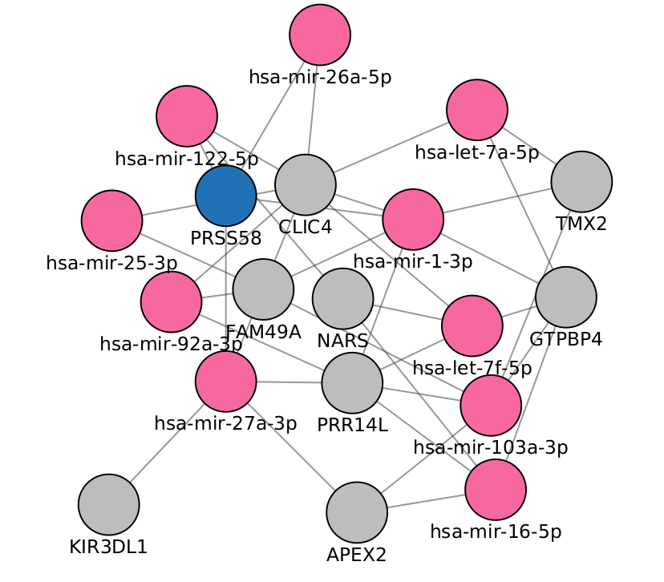
Notes:
This is a network generated from up regulated genes from Old with respect to middle age.
MTND4P24 MTCO3P22 RPL10P9 CLIC4 MTCO1P12 GTPBP4 PRSS44 NARS TMX2 FAM49A
PRR14L PRSS58 CDY8P AL136455.1 TRBC2 RBPJP5 APEX2 AC140504.1 FAM3C2 KIR3DL1
With the minimal network option.

Slide 30
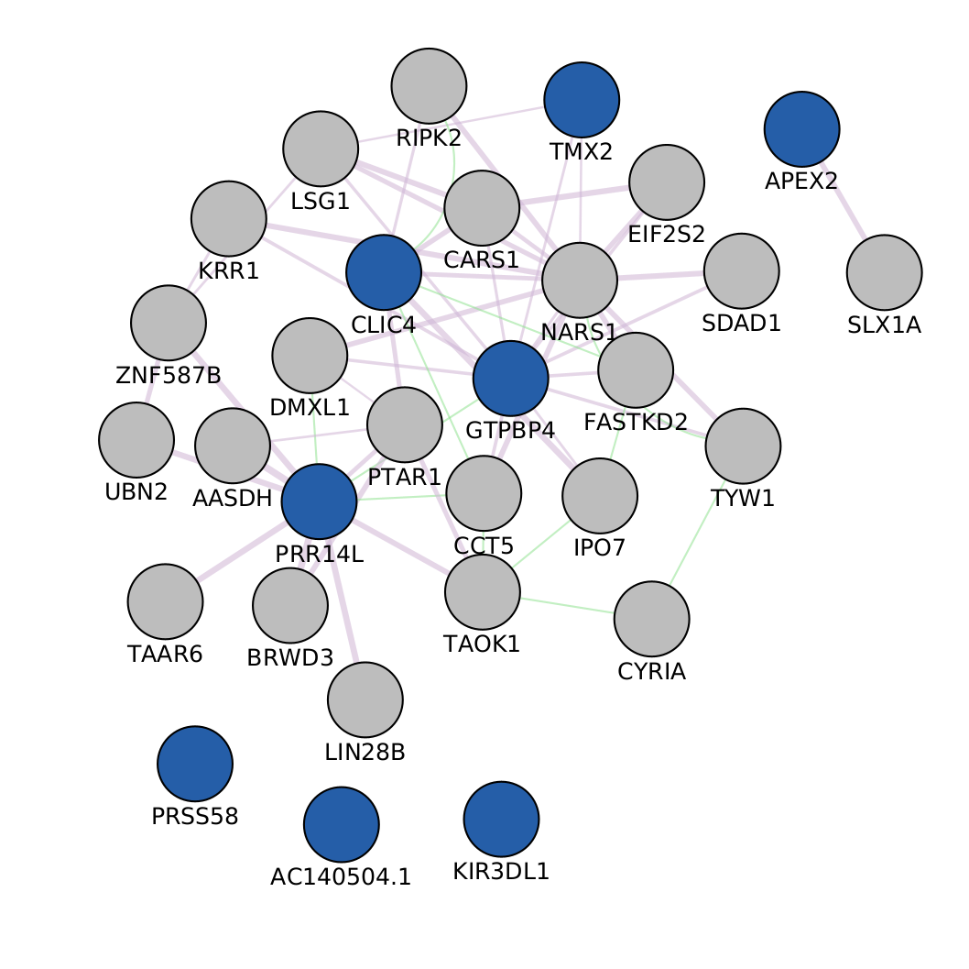
Notes:
The network you see here, is the result from GeneMania on the same 20 genes (selecting some for illustrative proposes)
The network generated will then be increased with the microRNAs on those nodes

Slide 31
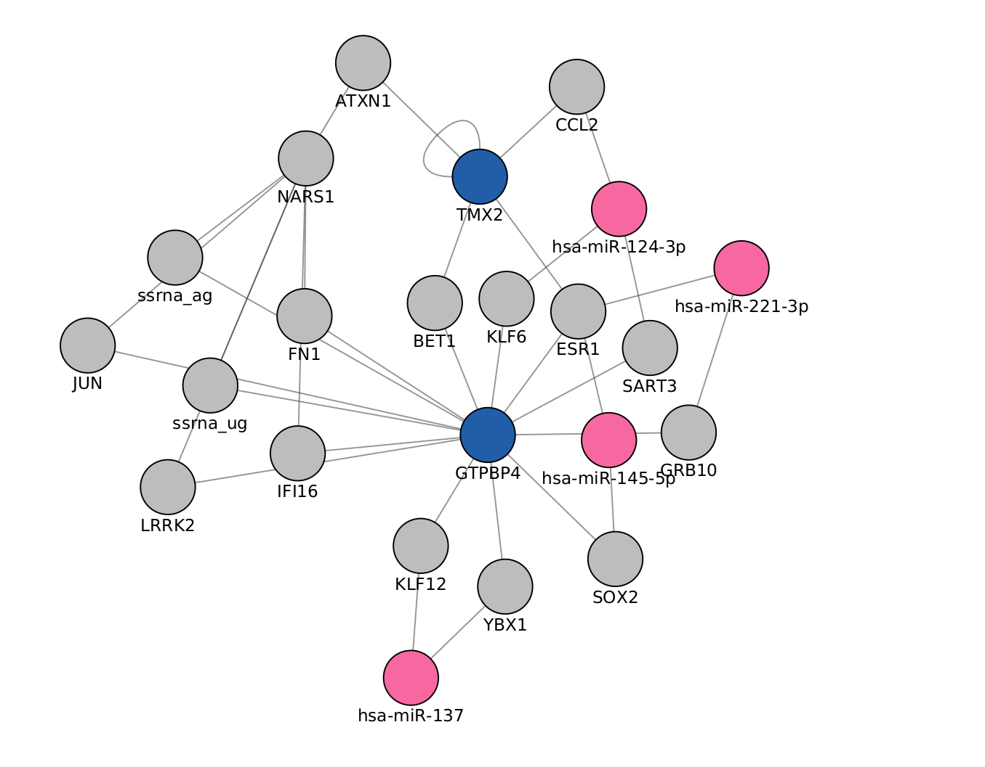
Notes:
The picture you see is the final network of the up regulated genes from Old with respect to middle age microRNAs. Using IntAct and closeness centrality

Slide 32
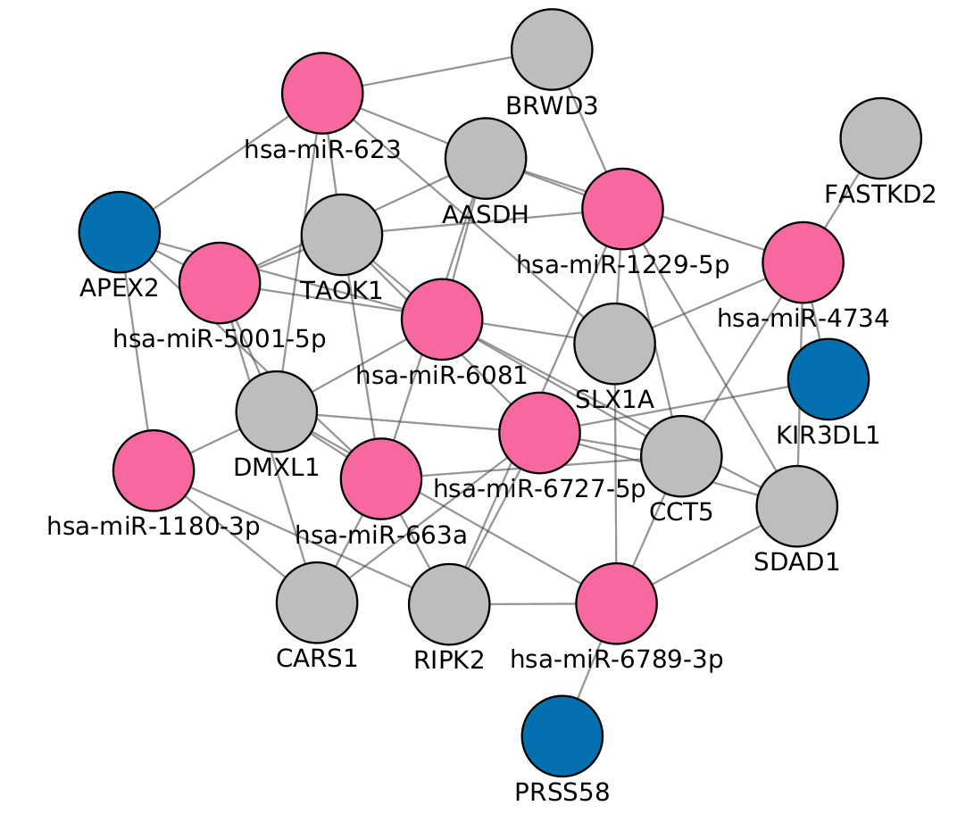
Notes:
The picture you see is the final network of the up regulated genes from Old with respect to middle age microRNAs. Using Genemania and PageRank centrality

Slide 33
50% IntAct + Closeness centrality
20% mirNet
23%
GeneMania + PageRank
Differentially expressed?
Notes:
Now that we have the networks, we need to evaluate the selected nodes and genes. We are exploring collecting genes and microRNas in muscle diseases to compare to them, but until know we register the genes and microRNAs expressed in muscle.

Slide 34

Notes:
Clean up the evaluation system
Define criteria for microRNA and gene selection
Select the microRNAs to send to the lab
Re run different configurations to find the best output
Work on the database

Slide 35
Questions?
?
Notes:
35

Slide 36
Thank You

Slide 37
Acknowledgements
This presentation has emanated from research conducted with the financial support of Science Foundation Ireland under Grant number [18/CRT/6214 ]

Slide 38
Next steps
Clean up the evaluation system
Define criteria for microRNA and gene selection
Select the microRNAs to send to the lab
Re run different configurations to find the best output
Work on the database

